Slide 1
Iot smart parking management system
sensors(ultrasonic sensors,servo motor
Esp32 wifi microcontroller
Arduino ide
Mqtt Broker(Mosquitto)
PARK POA WEB APP HOSTED BY GOOGLE FIREBASE
GOOGLE FIREBASE REALTIME
DATABASE
PYTHON BRIDGE(PAHO MQTT LIBRARY)

Slide 2
Perception layer
Smart parking management system perception layer consists of ultrasonic sensors,the ultrasonic sensors are used to detect cars entering or leaving the parking zone which will then identify slot availability in the parking zone
The servo motor in the case of smart parking management system functions as an actuator it automatically closes and opens the gate based on slot availability,if the are no slots in the parking zone the servo motor does not trigger the gate to open

Slide 3
Network layer
The massive data collected by the ultrasonic sensor is transmitted to the Arduino ide via ESP32 wifi microcontroller using wifi,Arduino ide publishes topics to mosquitto mqtt broker,the python bridge then subscribes to the topics published in the mqtt mosquito broker
Topics used in the project
Available slots
Slots occupied
Gate status
Total slots

Slide 4
Service management layer
It consists of the python bridge which bridges the mosquito mqtt broker with google firebase real time database cloud platform hosted remotely in asia.the realtime database updates the slots depending on the data acquired by collected by the ultrasonic sensors
In addition to processing the data acquired the google firebase also provides storage mechanism for the data.

Slide 5
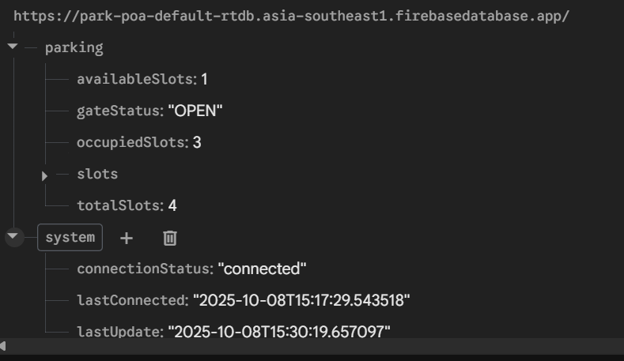
Google firebase

Slide 6
Application layer
Consist of a web app hosted by google firebase.the web app enables drivers to get an update of the slot status in the parking zone therefore preventing unwanted congestion.

Slide 7
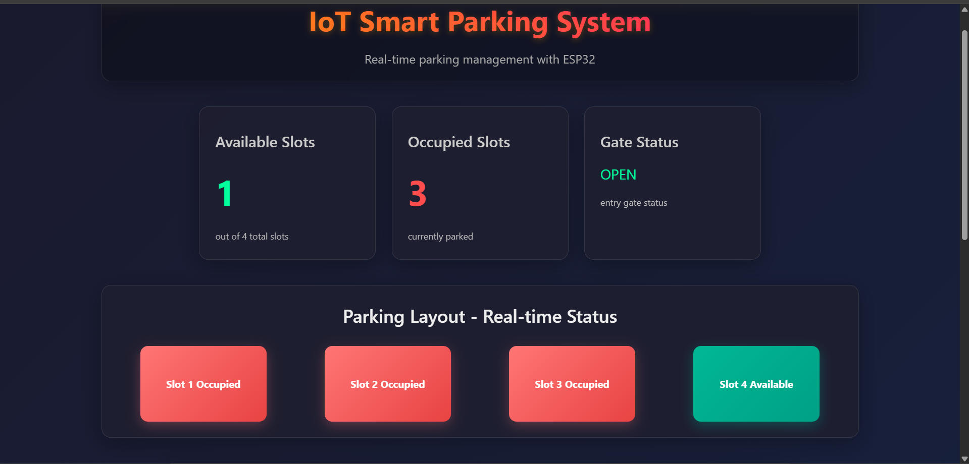

Slide 8
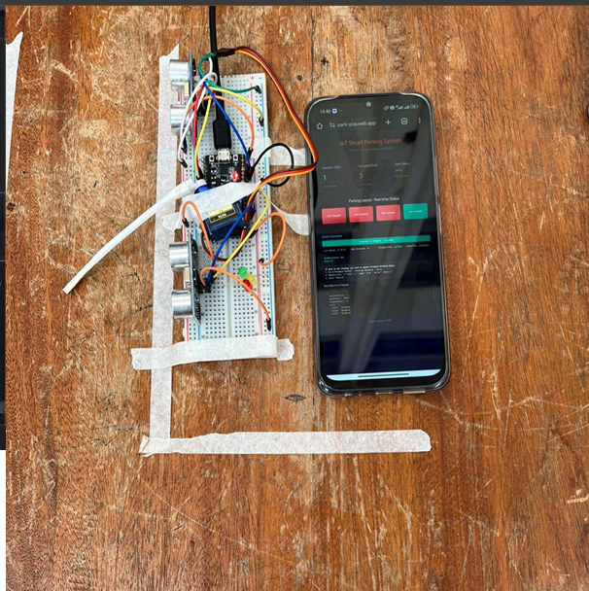
Project prototype

